Slide 1
Exam/Course Updates
Will plan to do more R-walkthroughs in class
Everything due Tuesday before class
Quiz
Group Work
Problem Set
But stay disciplined! Monday will be overwhelming if you wait…

Slide 2

Yay…..More Inferential Statistics
☺ ☺ ☺
T-tests
Tests Between the Means of Different Groups
Aka Comparison of Two Means

Slide 3
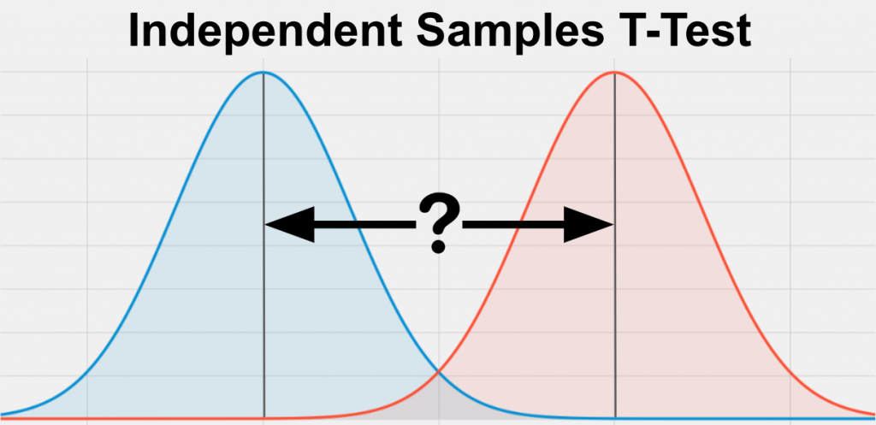
This is what a t-test does:
Are these the same, or different?

Slide 4
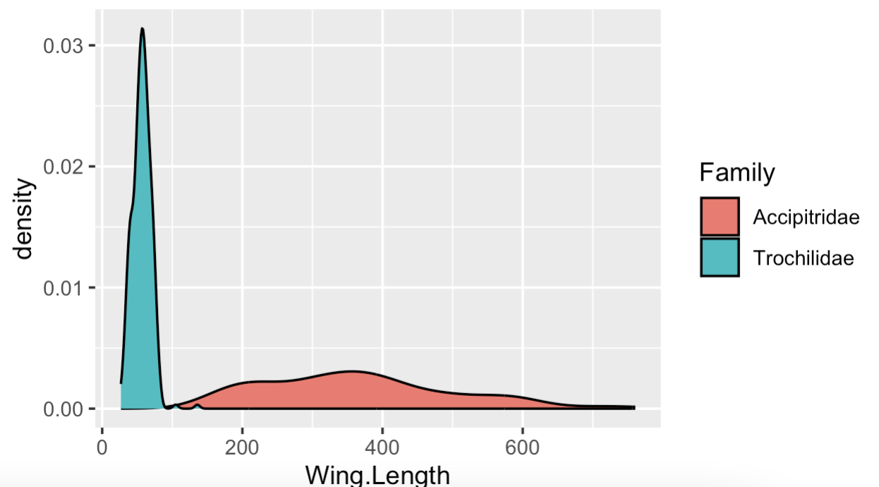
This is what a t-test does:
Are these the same, or different?

Slide 5
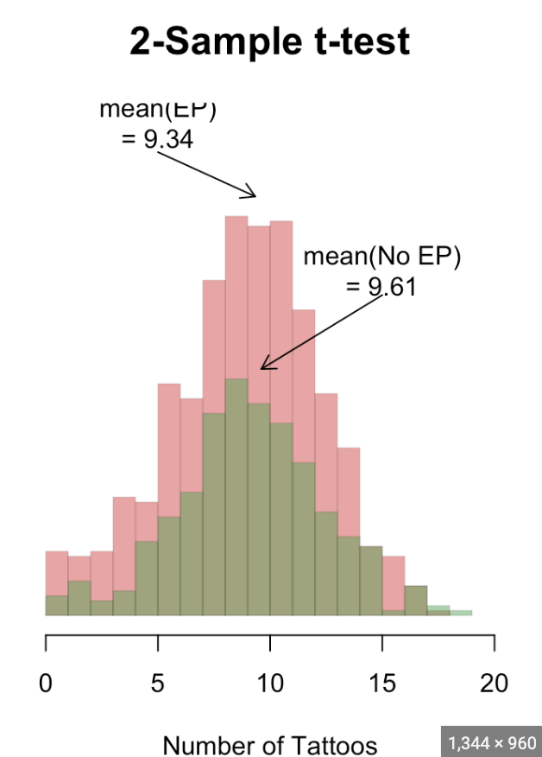
This is what a t-test does:
Are these the same, or different?

Slide 6
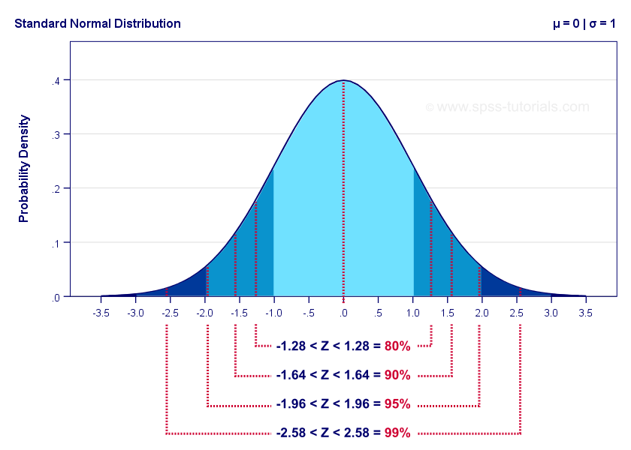
Z-test vs. t-test
For a z-test, what do we know about our population?
Mean
Standard Deviation

Slide 7
Z-test vs. t-test
For a z-test, what do we know about our population?
Mean
Standard Deviation
So what do we do if we don’t know the true standard deviation???

Slide 8
Z-test vs. t-test

Slide 9
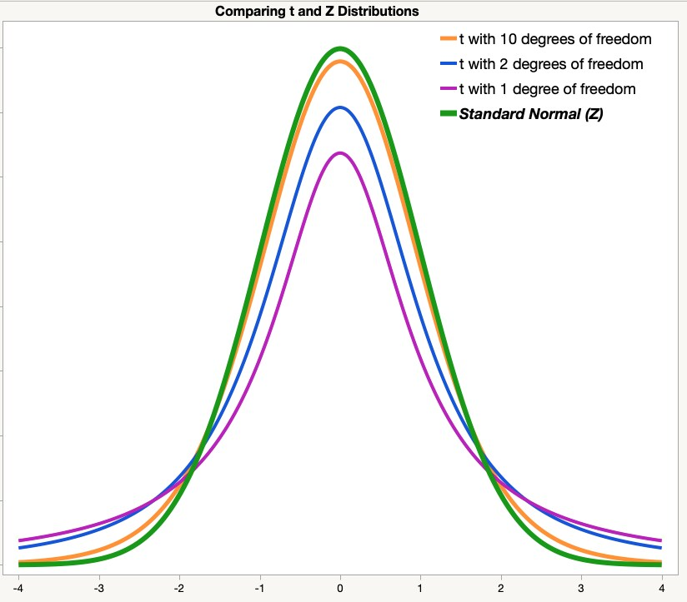
Z-test vs. t-test
A t-distribution is basically a z-distribution when we don’t know what the standard deviation is – so we have to estimate, which makes us less confident in our results.
See how the middle of the distribution is smaller and the tails are thicker?

Slide 10
Z-test vs. t-test
A t-distribution is basically a z-distribution when we don’t know what the standard deviation is – so we have to estimate, which makes us a bit less confident in our results.
See how the middle of the distribution is smaller and the tails are thicker?
That means our critical values will end up needing to be higher to get the same p-values as a z-distribution

Slide 11
Z-test vs. t-test
A t-distribution is basically a z-distribution when we don’t know what the standard deviation is – so we have to estimate, which makes us a bit less confident in our results.
See how the middle of the distribution is smaller and the tails are thicker?
A t-distribution with a sample size of infinity IS a z-distribution.

Slide 12
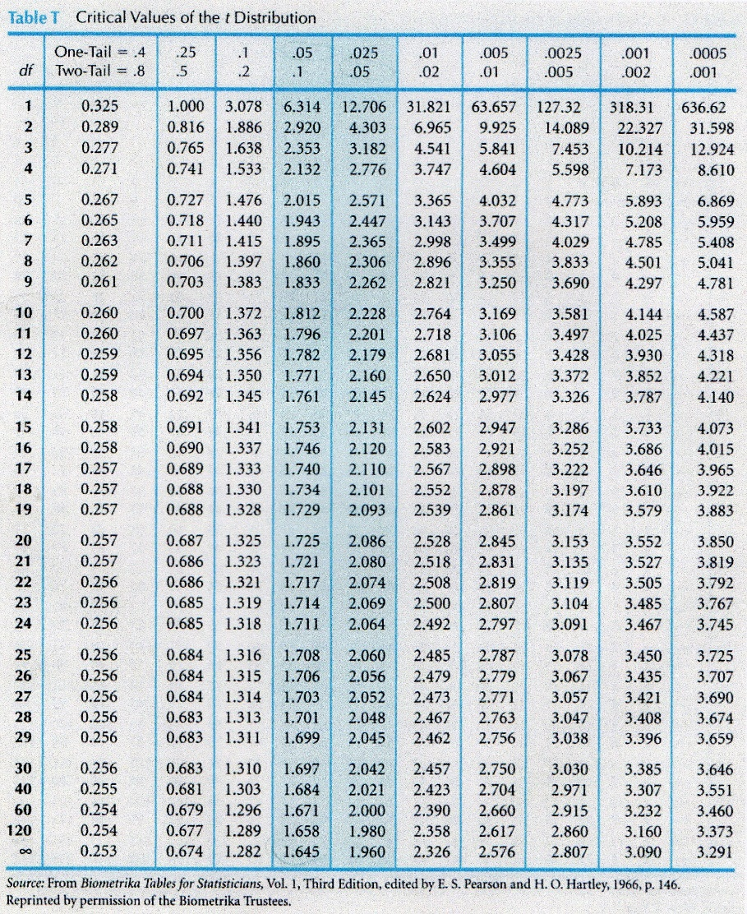
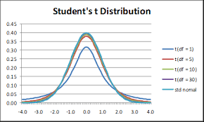
Z-test vs. t-test
A t-distribution with a sample size of infinity IS a z-distribution.

Slide 13
Degrees of Freedom
Degrees of freedom is, for most purposes, sample size minus the number of things you want to estimate.
Don’t worry about memorizing a definition, just know when to use it and what it means for your analysis.

Slide 14
Z-test vs. t-test
So…
You’ve done z-tests!
This is basically the same setup and procedures, with a few modifications to account for two things:
comparing two samples
we don’t know the standard deviation

Slide 15
When would you run a t-test?
Use the normal t-test when:
You have a continuous response variable
You want to test for a difference between two sample means: considering the variance within each group, do the groups belong to two distinct populations, or not?
Data is normally distributed and both groups have approximately equal variance
If the groups are not related in any way = Independent t-test
If the groups are related (paired) = Dependent t-test (or matched pairs t-test)

Slide 16
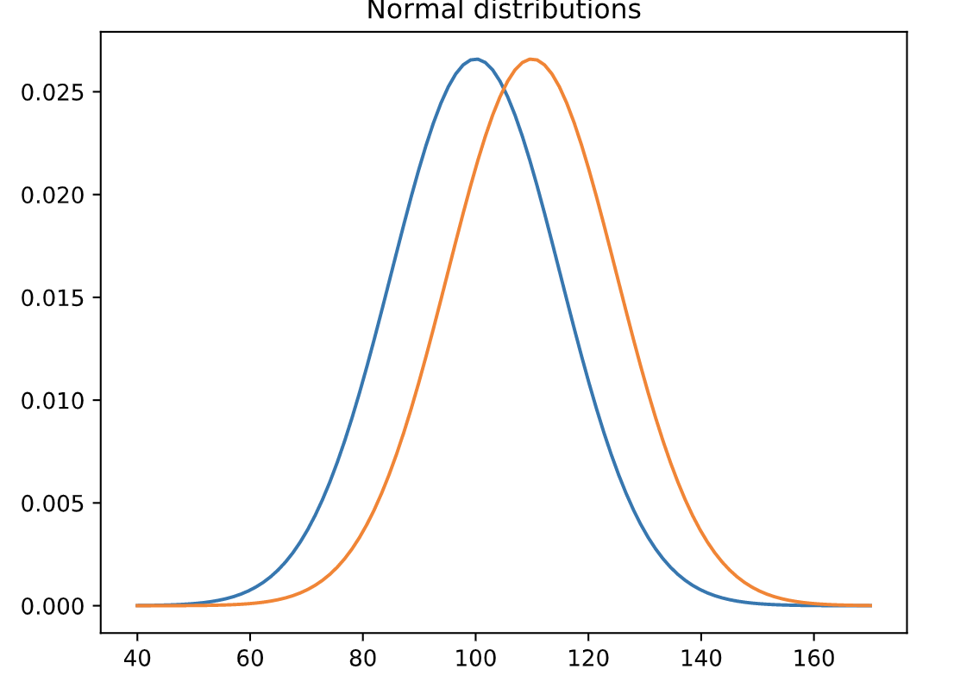
When would you run a t-test?

Slide 17
When would you run a one-sample z-test?
Type of Response Data
Continuous Counts (Frequency) Categorical
Research Question
Difference Relationships Predictions
# Samples to Compare
One Two >Two
Are Samples Independent?
Yes No
Parametric
Non-Parametric
One sample z-test
Independent t-test
Dependent t-test (matched pairs)
Wilcoxon signed rank
z-test
Wilcoxon signed rank Independent t-test
Wilcoxon signed rank Dependent
t-test

Slide 18
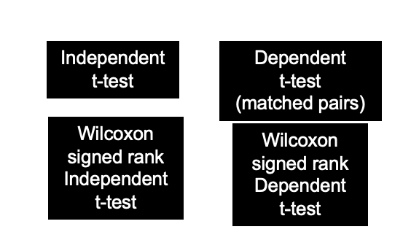

Four Options:
Unpaired
Paired
Normal

Slide 19
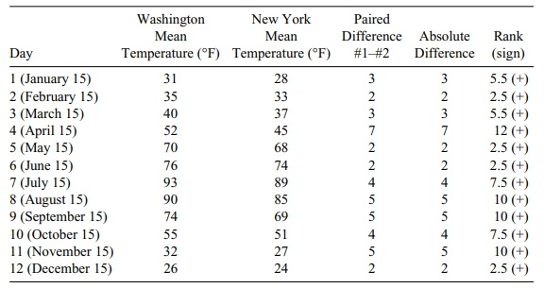
Normal vs. Non-parametric
For Wilcoxon, test is done on these ranks:

Slide 20
Independent vs. Dependent groups
How do I know if my samples are independent or dependent?
Can you tell exactly which observation should be paired with which other observation? If you can’t tell, your groups are independent
Examples of Independent Samples
Treated and untreated, randomly located plots
Monitoring sites set up with Systematic (grid) sampling
Infested and uninfested forest stands selected with stratified random sampling
Examples of Dependent Samples
Before and After data taken on the same observation
Paired watersheds / plots
Parent / offspring studies
Twin studies / partner studies

Slide 21
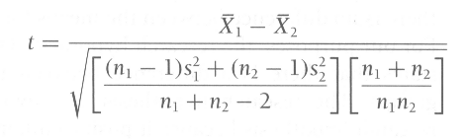
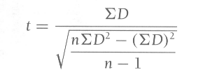
Independent vs. Dependent groups
Independent t-test quantifies the difference between sample means (numerator) vs. the amount of variability in the samples (denominator)
DF (for the critical value) =
DF (for the critical value) = (n₁ + n₂)-2
Dependent t-test quantifies the magnitude of the difference between paired observations (numerator) vs. the amount of variability in the samples (denominator)
DF (for the critical value) = n-1
where n is the number of paired observations

Slide 22


Basic Steps for an Inferential t-Test
Our quest for the nest two weeks:
Learning the nuances.

Slide 23
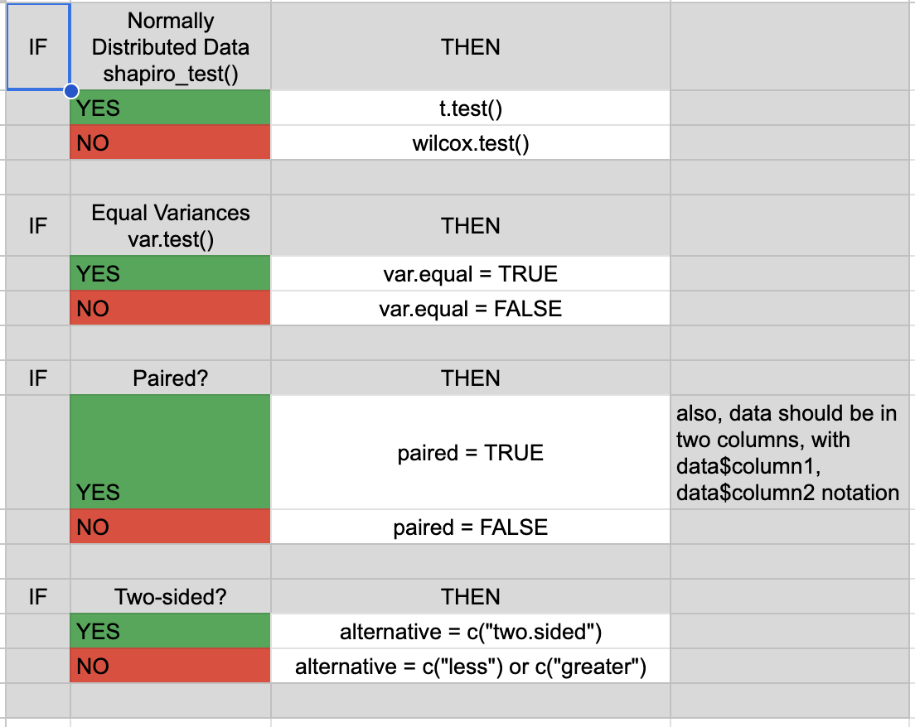

Slide 24
Basic Steps for an Inferential t-Test
Assume that you have a research question and data in hand
Follow these steps:
A statement of null hypothesis. H₀ = u₁ = u ₂
Set the level of Type I error risk (alpha)
Test for assumptions
Analyze data distribution
Test for equal variance between groups
Independent or dependent groups
Choose the appropriate test.
Compute the test statistic (obtained) value
Assess significance:
Determine the critical value needed to reject the null hypothesis and compare it to your calculated test statistic
Determine the p-value associated with your calculated test statistic
Summarize
(Know the research Hypothesis)
Including if a 1 or 2-tailed test
Usually < 0.05 but adjustable to manage power
(parametric or non-parametric)
(Pooled or unpooled)
(Independent or Dependent)
(e.g. one-tailed, independent pooled t-test)
Calculated from formula
|calculated| > critical value = significant
Clear, succinct paragraph with all pertinent information and interpretation
P-value < alpha threshold = significant

Slide 25
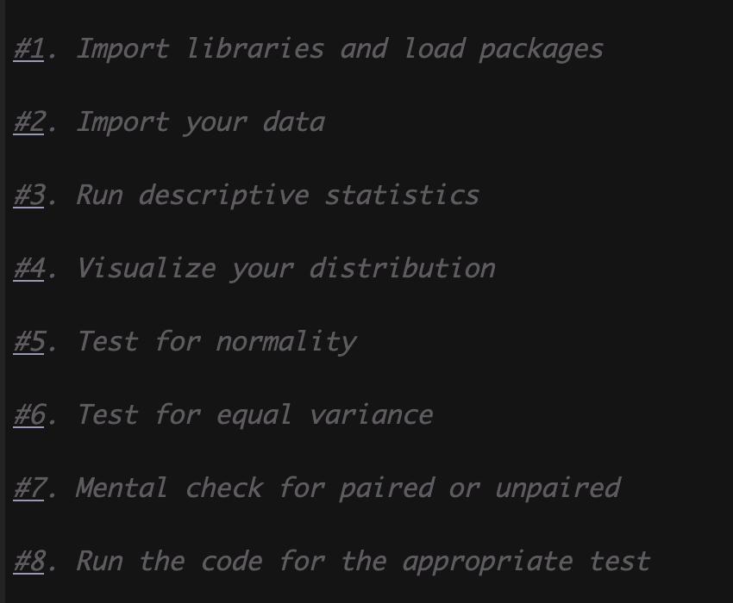
Steps in R

Slide 26
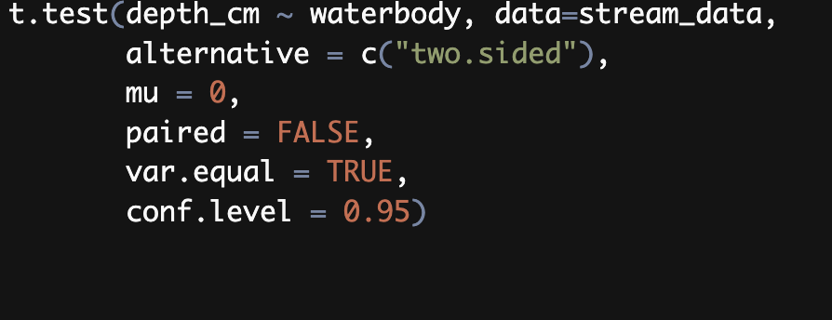
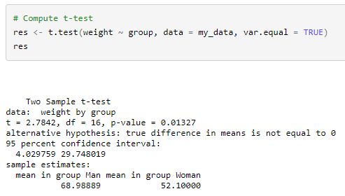
Using the Computer: Normal
Running a t Test using R –
Arguments can call for:
One or two-tailed
Mu is NULL difference
Independent or dependent
Equal or unequal variance

Slide 27
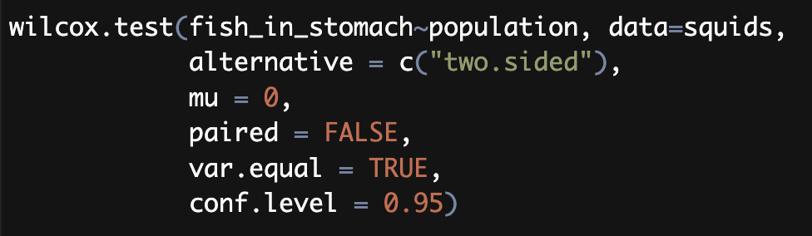
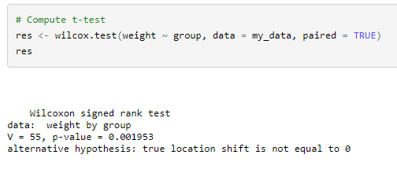

Using the Computer: Wilcoxon
Running a t Test using R –
Arguments can call for:
One or two-tailed
Mu is NULL difference
Independent or dependent
Equal or unequal variance

Slide 28
Basic Steps for an Inferential Test
Assume that you have a research question and data in hand
Follow these steps:
A statement of the hypothesis.
Describe your data
Choose the appropriate test based on your hypothesis.
Calculate the test statistic and find the appropriate p-value
Assess significance
Test Effect size for significant results
Summarize
Null H0 = there is no difference between the means of two groups
OR Null H0 = There is no significant difference between paired observations
Normally Distributed? Equal Variance?
Independent or dependent? Parametric or non-parametric, 1 or 2-tailed?
P-value < alpha threshold = reject the null = significant
Cohen’s Effect Size
Clear, succinct paragraph with all pertinent information and interpretation

Slide 29
Computing Effect Size (Cohen’s)
Effect size is a measure of how different two groups are from one another
…..a standardized difference between to group means
Cohen’s ES (d)
Small = 0.0 - .20
Medium = .20 - .50
Large = .50 and above
For the Independent t-test
For the Dependent t-test
D (mean of differences)
SD (stdev of the differences)

Slide 30
The Basic Steps for an Inferential Test – in R
Assume that you have a research question and data in hand
Follow these steps:
A statement of the hypothesis.
Work in R
Import libraries and load packages
Import your data
Run descriptive statistics
Visualize your distribution
Test for normality and other assumptions (equal variance)
Choose the appropriate test
Run the analysis in R and assess significance
Calculate Cohen’s Effect Size
Summarize

Slide 31
How to summarize your analysis
Key Components of a Statistical Summary
You paragraph summary of your statistical analysis should include the following:
Hypothesis or research objectives clearly stated
Brief summary of methods including the correct statistical test
Statistical result (significant or not significant) reported in shorthand with proper values and format (t_{(df)} = x.xxx, p = 0.xxx, Cohen’s ES = x.xx)
If significant add:
nature of result (which group has a higher mean)
Discussion of how meaningful results are – Cohen’s (consider power of your test and knowledge of the population)
Conclusions……..Your professional interpretation, with reference to the original research objective

Slide 32
Computing Effect Size (Cohen’s)
Effect size is a measure of how different two groups are from one another
…..a standardized difference between to group means
Cohen’s ES (d)
Small = 0.0 - .20
Medium = .20 - .50
Large = .50 and above
s
Use the standard deviation of the full data column for a more conservative estimate

Slide 33
How to summarize your analysis
Key Components of a Statistical Summary
You paragraph summary of your statistical analysis should include the following:
Hypothesis or research objectives clearly stated
Brief summary of methods including the correct statistical test
Statistical result (significant or not significant) reported in shorthand with proper values and format (t_{(df)} = x.xxx, p = 0.xxx, Cohen’s ES = x.xx)
If significant add:
nature of result (which group has a higher mean)
Discussion of how meaningful results are – Cohen’s (consider power of your test and knowledge of the population)
Conclusions……..Your professional interpretation, with reference to the original research objective

Slide 34


Now… fish
Lets practice:
We have 159 fish samples.
Choose 2 species (how about perch and pike)
We hypothesize that: Pike are larger than perch.
Remember all of the required steps for a statistical analysis
Statement of the null hypothesis H₀ = u₁ = u ₂
Set significance level p < 0.05
Test for normality assumption
Select the appropriate test
Calculate the test statistic

Slide 35
Now… fish

Slide 36
One group comes up and drives
Everyone else navigates…

Slide 37
Practice questions
Water bottle data
On BB
Download and try with your group

Slide 38

Example: Superfund Remediation

Slide 39
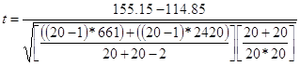
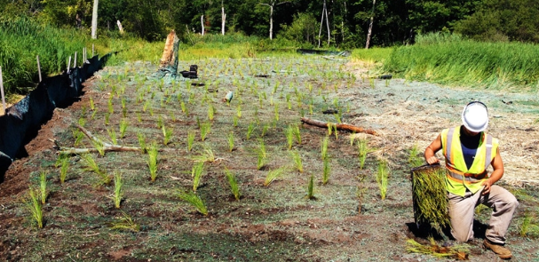
Example: Superfund Remediation
Brave enough to write it all in one cell?

Slide 40
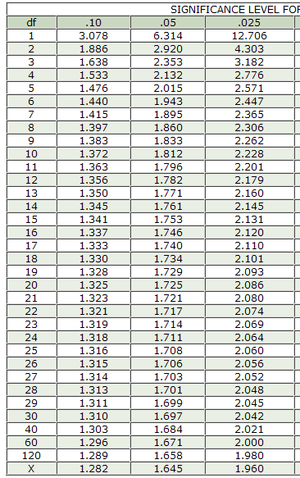
Example: Superfund Remediation
So we have a t-statistic = 3.25
We now need to determine the critical t-value for this test.
Assume we set the significance level to P<0.05
We know we have n1+n2-2 degrees of freedom = 20 + 20 – 2 = 38
Our research hypothesis was one tailed
Find the appropriate cell in the one tailed table
the critical t-value for this test = hmmmmm 38 isn’t in our table so we will go with the closest value (40)
critical t-value = 1.684

Slide 41

Example: Superfund Remediation
The decision:
Our calculated t-statistic of 3.25 is greater than the critical t-value of 1.68
We therefore reject the null hypothesis and conclude that:
Contaminated sites with plantings do have significantly lower levels of MTBE after 1 year t ₍₃₈₎ = 3.25, p < .05

Slide 42
Example: Superfund Remediation
The decision:
In excel we can use our excel function to calculate the exact p-value associated with cumulative distribution function for this test
Because we hypothesized that the first group (X1 unremediated) would be greater than the second group (X2 remediated) we have a one tailed (right tailed test)
T.DIST.RT(3.25,38) = 0.00121
t ₍₃₈₎ = 3.25, p = 0.001

Slide 43

Example: Superfund Remediation
Is this difference meaningful?
Cohen’s ES (d)
Small = 0.0 - .20
Medium = .20 - .50
Large = .50 and above
ES = 40.30 = 0.92
43.789

Slide 44
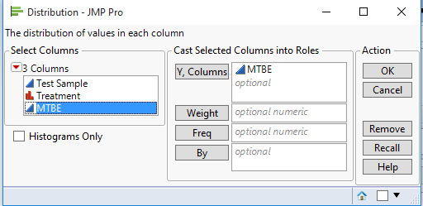
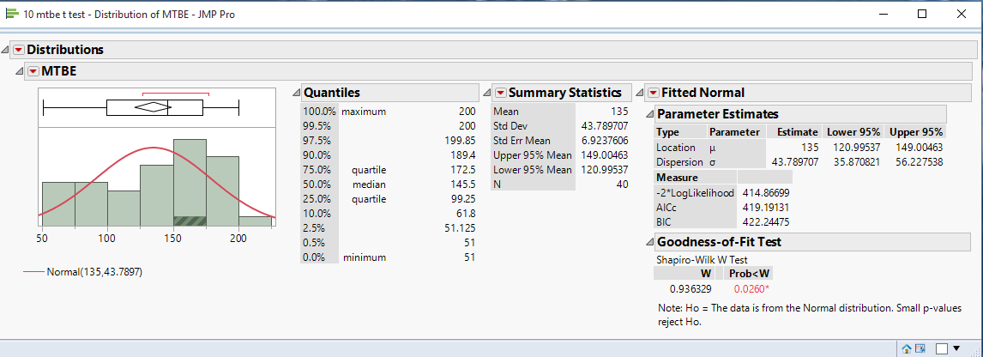
Example: Superfund Remediation
Doing this in JMP

Slide 45
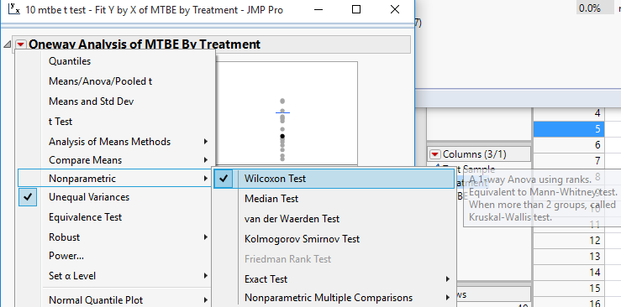
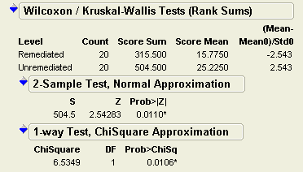
Example: Superfund Remediation
Doing this in JMP
Two tailed test
One-tailed test

Slide 46
Example: Superfund Remediation
We tested to see if remediated locations at this superfund site had significantly lower MTBE concentrations after one year. Using a one-tailed Independent Wilcoxon Signed Rank t-test to compare our 40 stratified random soil samples we found a significant and meaningful difference between the treatments (t ₍₁₁₎ = -6.53, p = 0.0106, ES = 0.93). This indicates that using remediation strategies can be a valuable approach to removing MTBE pollutants from similar systems.

Slide 47
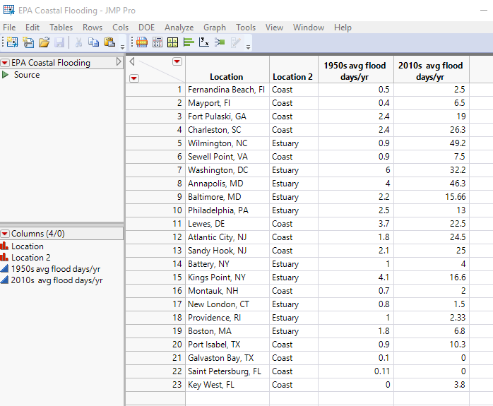

Example: USGS Flooding
The USGS monitors flood gauges across the US. There is some hope that locations with functioning estuaries will help mitigate flooding as sea level rises. But do they?
Is there a difference in recent flooding frequencies (2010’s average) between estuary and coastal locations?

Slide 48

Example: USGS Flooding
Null hypothesis: there is no difference in the 2010 flood days/yr between coastal and estuary USGS flood gauges
Alpha threshold: 0.05
Test: 2-tailed independent t-test but we don’t know if it is parametric or non-parametric, pooled (equal variance) or unpooled (unequal variance). So we need to test those assumptions before we calculate a test statistic.

Slide 49
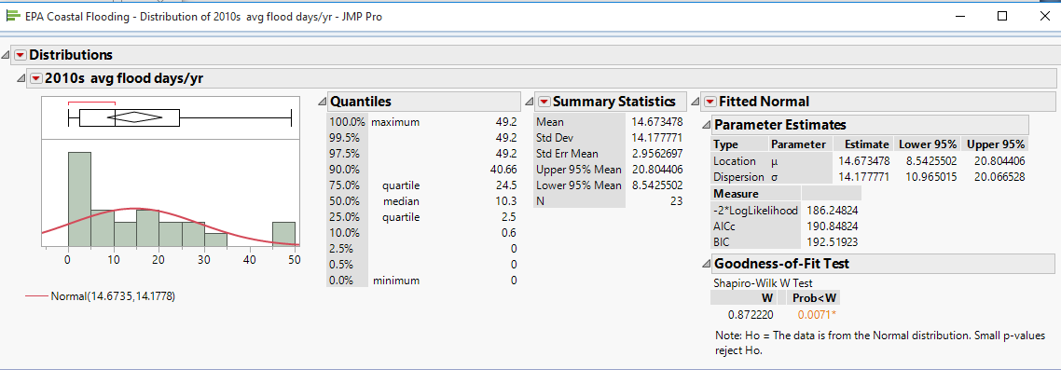
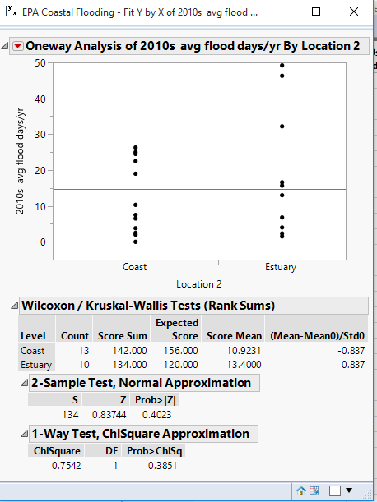
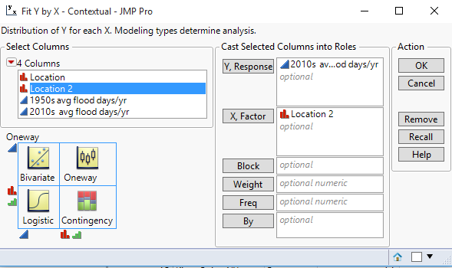
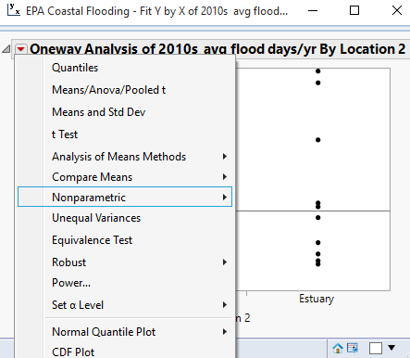
Example: USGS Flooding
Data is not normal

Slide 50
Example: USGS Flooding
We tested to see if there was a difference in flooding frequency at estuaries and coastal locations. Using a two-tailed, Wilcoxon, signed Rank Independent T-test [t₍₂₁₎ = 0.8374, p=0.4023] we found no significant difference between location types. This indicates that flooding frequency is not mitigated by inland status, and all locations near waterways may face similar frequency of flooding events.

Slide 51
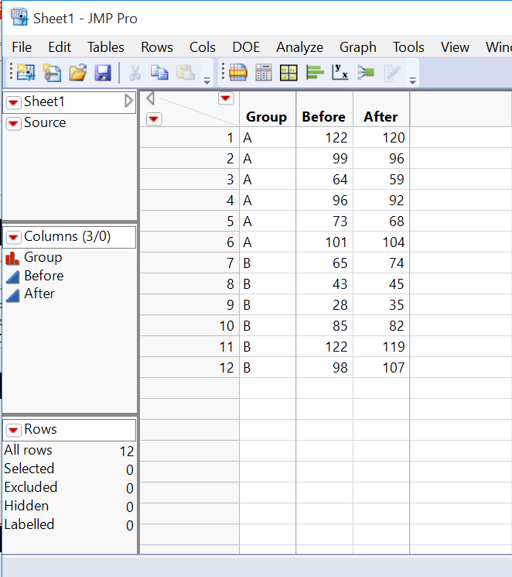
Example: Herbicide impacts
An herbicide treatment is applied plots in group A (Group B is a control) and biomass measured 1 week before and one week after application.
We want to be sure there is no difference between the two groups prior to the treatment.
Is there a difference in the BEFORE concentration between Group A and Group B?

Slide 52
Example: Herbicide impacts
Null hypothesis: there is no difference in the BEFORE biomass between Group A and Group B?
Alpha threshold: 0.05
Test: 2-tailed independent t-test but we don’t know if it is parametric or non-parametric, pooled (equal variance) or unpooled (unequal variance)
So we need to test those assumptions before we calculate a test statistic.

Slide 53
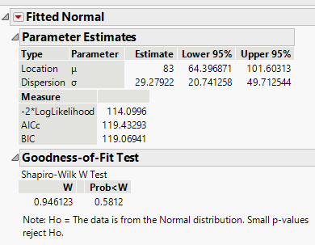
Example: Herbicide impacts
Is there a difference in the BEFORE concentration between Group A and Group B?
Assumptions met?:
Data is normally distributed …….
Now we need to get into the Fit Y by X platform to test for equal variance as well.

Slide 54
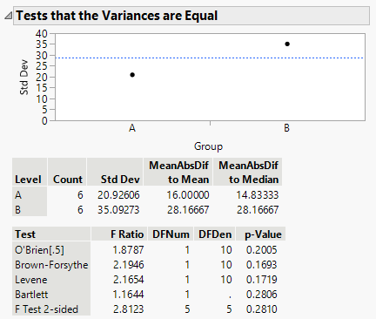
Example: Herbicide impacts
Is there a difference in the BEFORE concentration between Group A and Group B?
Assumptions met?:
Pick any one of these … they rarely disagree
Looks like we accept the null:
The sample have equal variance.

Slide 55
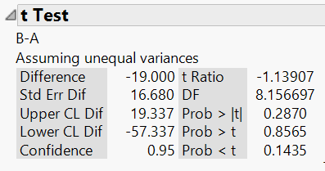
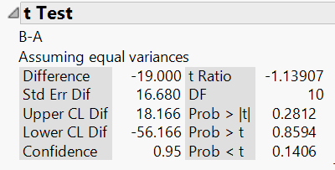
Example: Herbicide impacts
Is there a difference in the BEFORE biomass between Group A and Group B?
Test: 2-tailed pooled independent t-test
Alpha threshold: 0.05
Obtained Value: -1.139
Degrees of Freedom: 10
Appropriate p-value: 0.2870
Result: no significant difference
T-test
Means/ANOVA/Pooled t
Note: If doing by hand the associated critical value: 2.228

Slide 56
Example: Herbicide impacts
We tested to see if there was a difference in biomass between a treatment and control group prior to herbicide application. Using a two-tailed pooled Independent T-test [t₍₁₁₎ = -1.139, p=0.2812] we found no significant difference between groups. This indicates that the treatment and control groups are similar at the start of this experiment, suggesting a suitable sample design to run further tests on the impact of this herbicide treatment on biomass.

Slide 57

Example: Butterflies and Pesticides
In her biology Lab, Amy has painstakingly measured the wing length of 80 butterflies. 40 of them were exposed to pesticides during development and 40 were not
She wants to determine if there is a difference in wing length between the two groups.

Slide 58
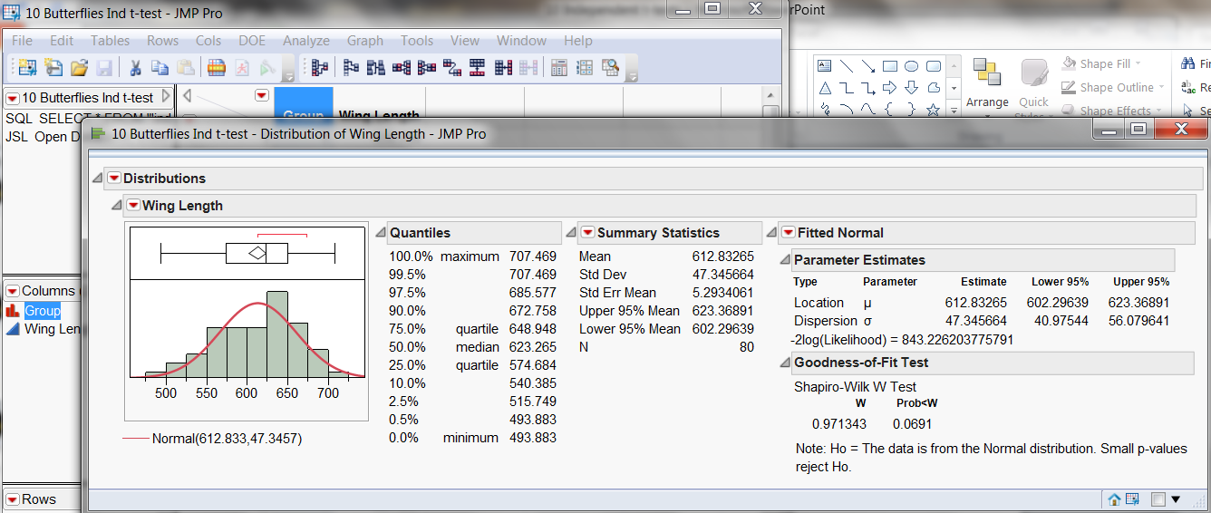
Example: Butterflies and Pesticides
In JMP it is easy to test for normality…so let’s be sure to start there
Looks like we just barely meet our assumptions…but we do meet them.

Slide 59
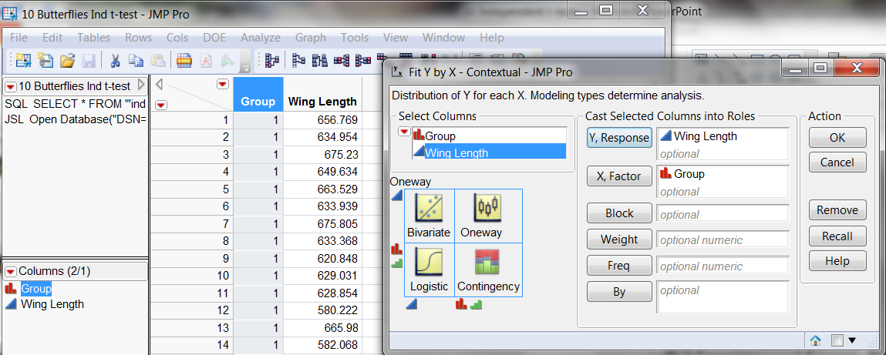
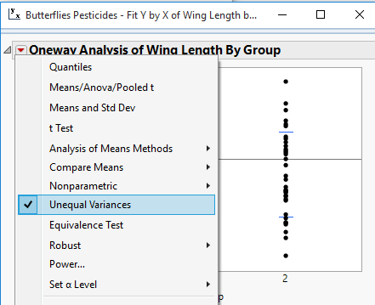
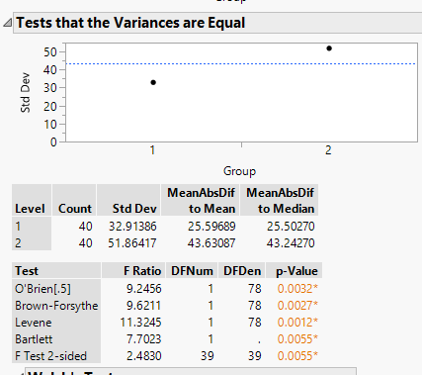
Example: Butterflies and Pesticides
Test for Unequal Variance
NOT EQUAL

Slide 60
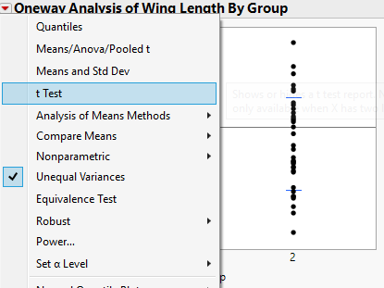
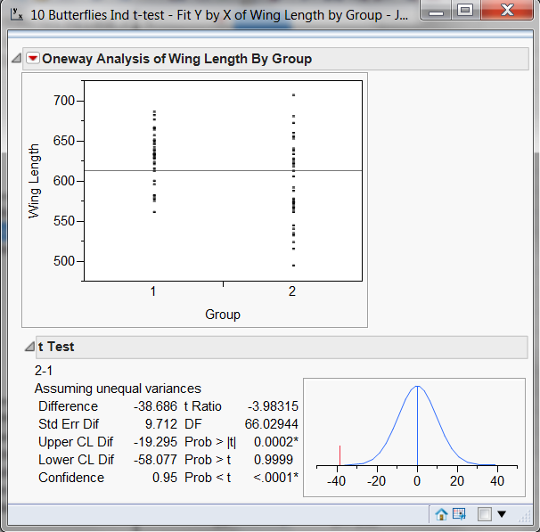
Example: Butterflies and Pesticides
Now we can report that
t(66.02) = 3.98, p =0.0002

Slide 61
Example: Butterflies and Pesticides
Cohen’s Effect Size
-38.69 = 0.817 = highly meaningful
47.35

Slide 62
Example: Butterflies and Pesticides
We tested to see if there was a difference in wing length between butterflies treated with pesticides during development and a control group. Using a two-tailed, Independent unpooled t-test (t _{(66.02)} = 3.98, p = 0.0002, ES = 0.82) we found that butterflies treated with pesticides had significantly shorter wing length. This highly meaningful difference indicates that pesticides may impact butterfly development and applications should consider the impact to local butterfly populations.

Slide 63

Group Work – Ind T-tests

Slide 64

Group Work – Ind T-tests Live BA
Your first task will be to examine if there is a difference in live basal area (m²/ha) between ice treated and control plots from data collected one year after the initial treatment.

Slide 65
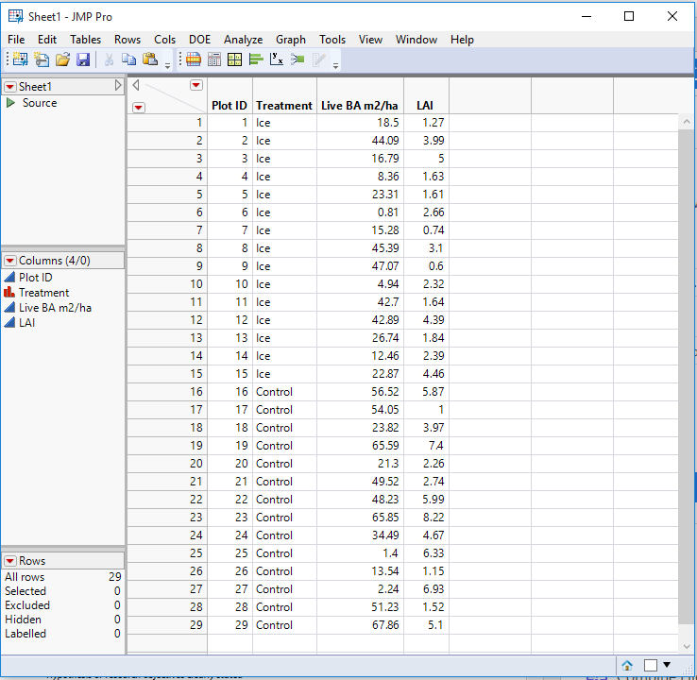
Group Work – Ind T-tests Live BA
First we will walk you through the steps for an inferential test with this basal area data to make sure you remember all of the steps.
Then you will summarize it all in a concise paragraph.
Use an alpha level of 0.05 and assume this is a two tailed test.

Slide 66
Group Work – Ind T-tests
Remember that any summary should include the following:
Hypothesis or research objectives clearly stated
Correct statistical test selected and clearly stated
Dependent or Independent,
1 or 2 Tailed,
Student’s T Pooled (equal Variance), Students T Un-Pooled (unequal variance), or Wilcoxon (non-parametric)
Statistical result (significant or not significant) reported in shorthand with proper values and format:
t(df) = t statistic, p-value, ES)
If significant describe the nature of differences reported (which group is bigger)
Discussion of how ecologically and statistically meaningful results are with justification
Interpretation/Conclusions drawn with reference to the original research objective

Slide 67

Group Work – Ind T-tests LAI
Your next task will be to examine if there is a difference in leaf area index between ice treated and control plots one year after the initial treatment.

Slide 68
Group Work – Ind T-tests LAI
You are on your own for this one…..work through each of the steps and summarize your analysis in a concise paragraph.
Use an alpha level of 0.05 and assume this is a two tailed test.

Slide 69
Group Work – Ind T-tests
Remember that any summary should include the following:
Hypothesis or research objectives clearly stated
Correct statistical test selected and clearly stated
Dependent or Independent,
1 or 2 Tailed,
Student’s T Pooled (equal Variance), Students T Un-Pooled (unequal variance), or Wilcoxon (non-parametric)
Statistical result (significant or not significant) reported in shorthand with proper values and format:
t(df) = t statistic, p-value, ES)
If significant describe the nature of differences reported (which group is bigger)
Discussion of how ecologically and statistically meaningful results are with justification
Interpretation/Conclusions drawn with reference to the original research objective

